Slide 1
COMP1216 Software Modelling and Design
Thai Son Hoang, T.S.Hoang@soton.ac.uk
Yvonne Howard, ymhoward@soton.ac.uk
Michael Butler, mjb@ecs.soton.ac.uk

Slide 2
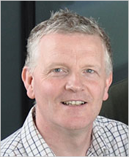

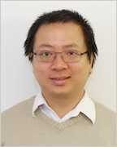
Your Lecturers…
Michael Butler
Lectures
Labs
Yvonne Howard
Lectures
Labs
Thai Son Hoang
Lectures
Labs

Slide 3
Introduction
Today’s Objectives
Housekeeping
The Motivations for COMP1216
The software crisis, its costs and causes?
Recent Software Glitches
(In)Famous Software Failures
Software Development Process
What will be covered in COMP1216?

Slide 4
Housekeeping 1:Teaching
Lectures: 3 per week:
Monday 1700 -1800 Location: B46-3001
Tuesday 1700 – 1800 Location B67-1037
Thursday 1700 – 1800 Location B32 - 1015
Workshops/Problem classes/
Either: Tuesday 1300 – 1400 Location B58 – 1067
Or: Friday 1600 – 1700 Location B58 – 1067
Your timetable will tell you which session to attend
Workshops start in week 2
Revision, week 12

Slide 5
Housekeeping 2: Assessment
The module is worth 15 credits
1/8 of your first year marks
You will be marked as follows:
Coursework 30%
Working in a group:
Requirements modeling
Event-B modeling
Hand in end of semester
Exam 70%

Slide 6
This module provides the foundation for:
Programming modules
Software engineering modules
Pretty much any project work

Slide 7
COMP1216 Overview
Introduction to Software Engineering
Requirements Engineering:
elicitation & specification, modeling, prototyping, verification & validation
..... Using UML (Unified Modeling Language)
….. And Event-B modelling method
Elements of Design:
Architecture, design patterns
Elements of Verification & Validation:
Testing

Slide 8
Background Resources 1
COMP1216 notes and announcements
Bernd Bruegge and Allen H. Dutoit. Object-Oriented Software
Engineering - Using UML, Patterns and Java
Pearson, 3rd edition edition, 2014.
Pearson International Edition
Ian Sommerville. Software Engineering
Addison-Wesley, 9th edition edition, 2011
Martin Fowler. UML Distilled
Addison-Wesley, 3rd edition edition, 2004
Eric Gamma, Richard Helm, Ralph Johnson, and John Vlissides. Design Patterns: Elements of Reusable Object-Oriented Software
Addison-Wesley, 1995

Slide 9
Background Resources 2
Jean-Raymond Abrial. Modeling in Event-B: System and Software Engineering
Cambridge University Press, 2010
www.event-b.org

Slide 10
Introduction to Systems

Slide 11
Definitions
“A system is a set of interacting or interdependent components forming an integrated whole”
Wikipedia
“a regularly interacting or interdependent group of items forming a unified whole”
Merriam Webster
“A set or assemblage of things connected, associated, or interdependent, so as to form a complex unity; a whole composed of parts in orderly arrangement according to some scheme or plan”
- Oxford English Dictionary

Slide 12
Definitions
“A system is a set of interacting or interdependent components forming an integrated whole”
Wikipedia
“a regularly interacting or interdependent group of items forming a unified whole”
Merriam Webster
“A set or assemblage of things connected, associated, or interdependent, so as to form a complex unity; a whole composed of parts in orderly arrangement according to some scheme or plan”
- Oxford English Dictionary

Slide 13
Definitions
“A system is a set of interacting or interdependent components forming an integrated whole”
Wikipedia
“a regularly interacting or interdependent group of items forming a unified whole”
Merriam Webster
“A set or assemblage of things connected, associated, or interdependent, so as to form a complex unity; a whole composed of parts in orderly arrangement according to some scheme or plan”
- Oxford English Dictionary

Slide 14
Definitions
“A system is a set of interacting or interdependent components forming an integrated whole”
Wikipedia
“a regularly interacting or interdependent group of items forming a unified whole”
Merriam Webster
“A set or assemblage of things connected, associated, or interdependent, so as to form a complex unity; a whole composed of parts in orderly arrangement according to some scheme or plan”
- Oxford English Dictionary

Slide 15
Systems Design
The application of systems theories to the design, development and deployment of software
Tackling the problem of creating a software system (software, hardware, etc) in order to solve a set of requirements
Elements of analysis and engineering

Slide 16
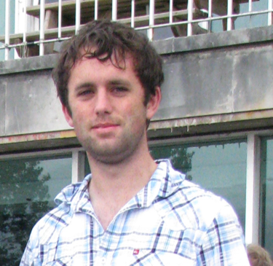
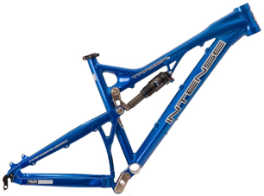
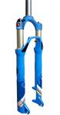
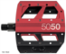
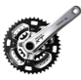




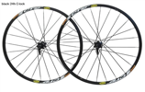
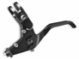
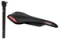

A System: components
Structured in a system of purposeful activity
Emergent property of the whole

Slide 17

Systems Analysis: Bloodhound SSC

Slide 18
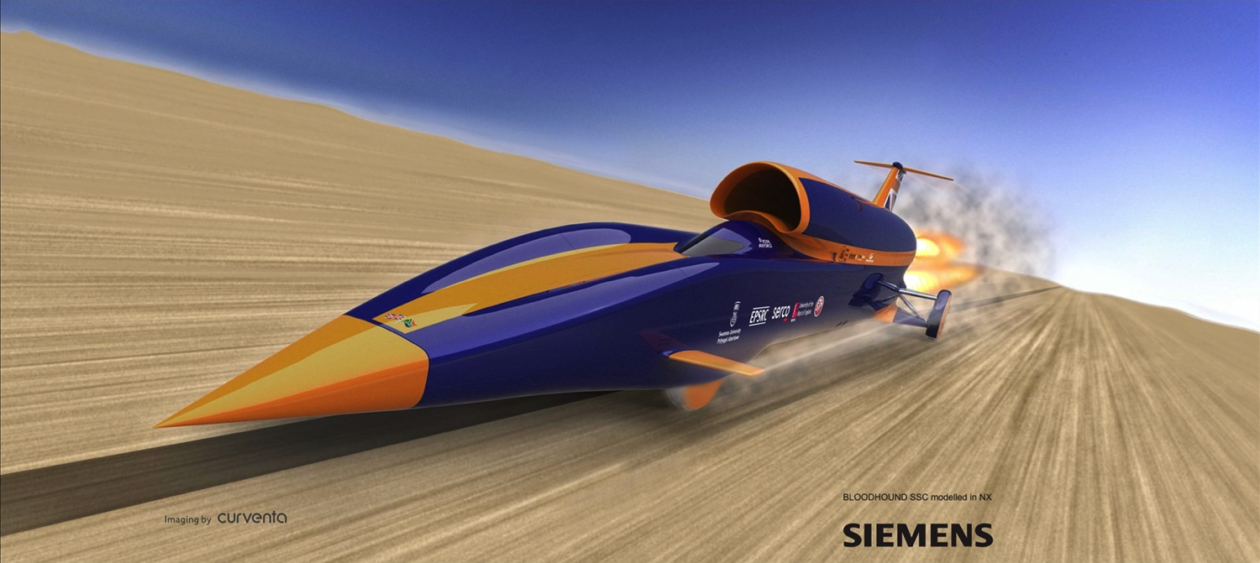
Systems Analysis: Bloodhound SSC
“A system is a set of interacting or interdependent components forming an integrated whole” - Wikipedia

Slide 19
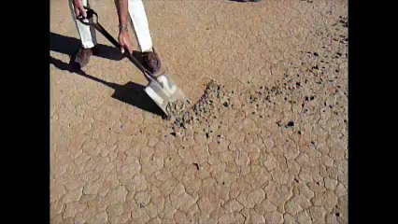
Systems Analysis: Bloodhound SSC

Slide 20
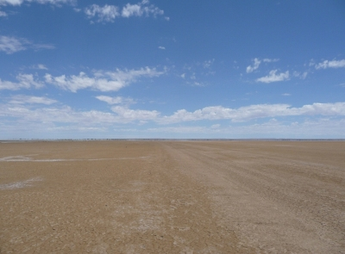
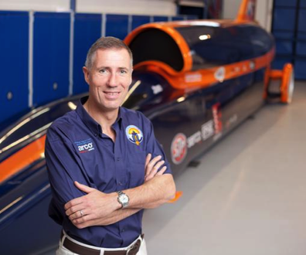
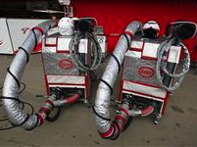
Systems Analysis: Bloodhound SSC
Are these part of the system?
The Surface
Hakskeen Pan, South Africa
The Driver
Wing Commander Andy Green
Refueling Rig
Refuel Jet
Replace Rocket

Slide 21


Different way to look at systems…
in the
Large
in the
Small
The Bigger Picture
The context: people, rules, organisations, beliefs and values
The Details
The specifics about a part of the system, what’s in it, how they are related

Slide 22
Different way to look at systems…
Will it work in practice?
How will the system work?
in the
Large
in the
Small
The Details
Requirements Engineering
Unified Modelling Language
Risk management
Verification & validation
Development Methodology
The Bigger Picture
Human Factors
Project Management
Cost & time estimation
…But we will not consider these

Slide 23
Why does this all matter?
Motivation: The software crisis, its costs and causes
Recent Software Glitches
(In)Famous Software Failures

Slide 24
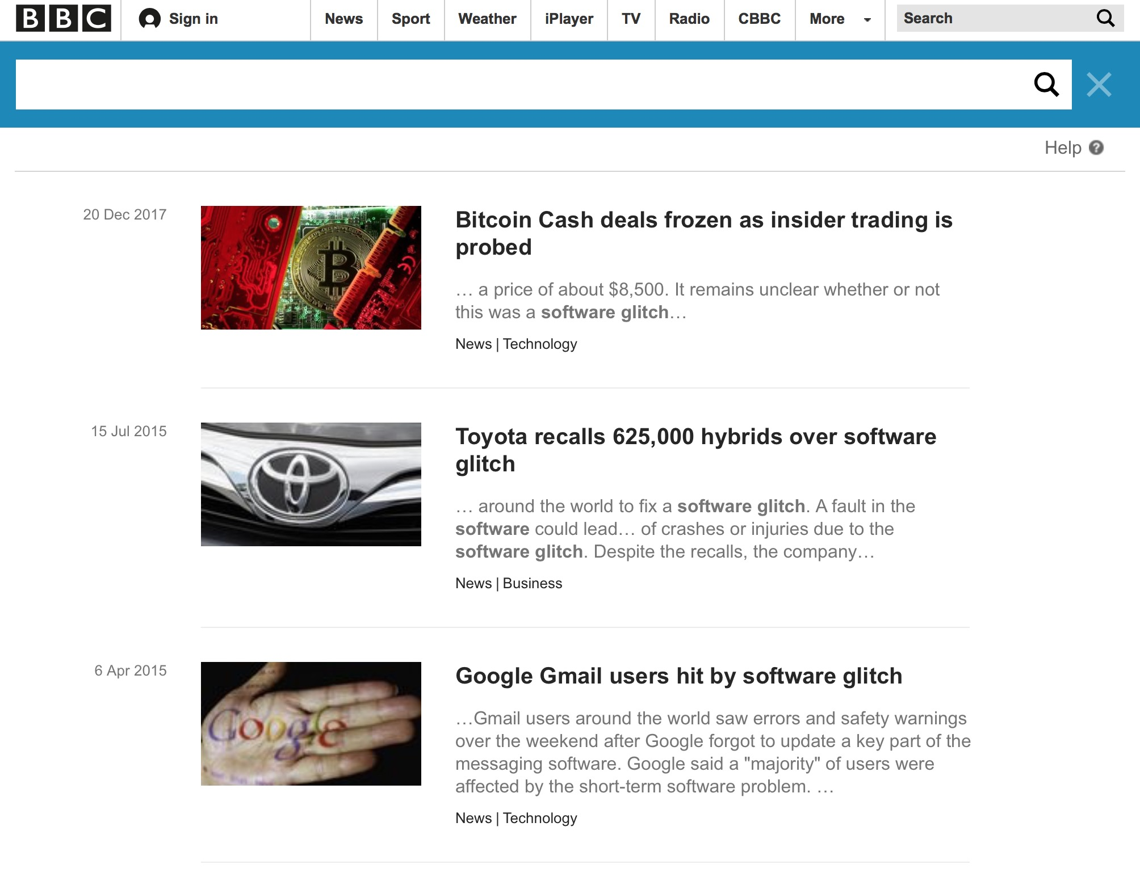
Recent Software Glitches 1

Slide 25
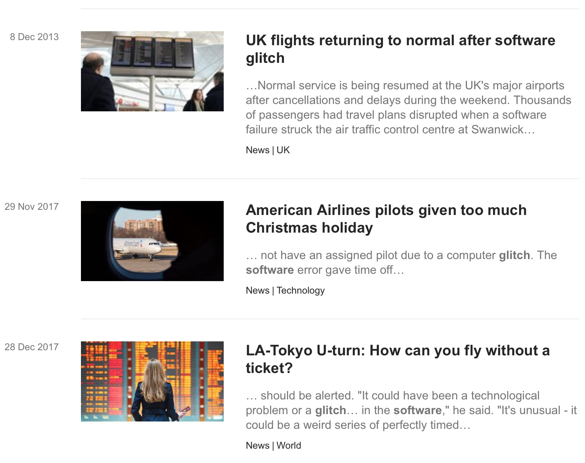
Recent Software Glitches 2

Slide 26
(In)Famous Software failures: Therac-25 (1985-1987)
Therac-25: Computer controlled radiation therapy machine
Machine can produce both:
Low energy electron beams for diagnosis
High energy X-ray photons for treatment
A turntable must be set up corresponding to each mode
A race condition allows high powered beams when the turntable is NOT set in the correct position i.e for diagnosis
6 people had massive overdoses
*source: Leveson [1995]

Slide 27
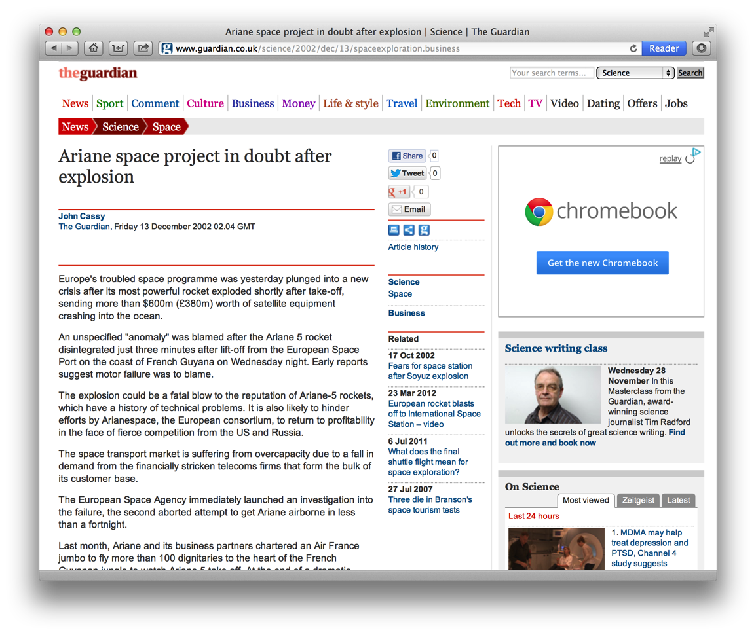
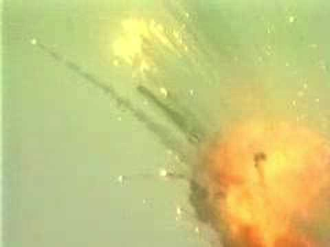
Why Does this all Matter? - (In)Famous Software failures 1996
Ariane 5
Guidance software failure
Rocket exploded shortly after takeoff
Cost: Development $7 billion + rocket and cargo $500 million
+ lost research
A systems failure in the small
https://www.youtube.com/watch?v=kYUrqdUyEpI

Slide 28
The Post mortem
Why did it happen?
Inertial computers failed because of overflow on one variable
Software exception stops these computers
These computers sent post-mortem info. through the bus.
The main computer thinks that it is velocity info.
It was confused and pivoted the nozzles
What was the cause?
The faulty program was working correctly on Ariane 4
The faulty program was not tested for Ariane 5
The velocity of Ariane 5 is far greater than that of Ariane 4
The faulty program happened to be for prelaunch only
Engineers left it run for the first 40s of flight ...
... To make it easier to restart the system in case of a brief delay

Slide 29
Software Engineering and the Software Development Process

Slide 30
Definition
Software Engineering: The practical application of scientific knowledge in the design and construction of computer programs and the associated documentation required to develop, operate, and maintain them.
Brings together …
A business problem
Computer science
Creativity
… to create a solution
Engineering implies:
Organization
Discipline
Methodical approaches

Slide 31
‘The capacity of the human mind for formulating and solving complex problems is very small compared with the size of the problem whose solution is required for objectively rational behaviour in the real world or even for a reasonable approximation to such objective reality’
- Herbert A. Simon, Carnegie Mellon.
Behaviour prediction when dynamic systems interact is a non-trivial task
How many concepts can you hold in your head at the same time?
Modelling and simulation are tools that help us to understand and predict this behaviour

Slide 32
Standish Report
2004
29% of technology projects are successful
53% are late, over budget, incomplete, or of poor quality
18% fail
2009
32% of technology projects are successful
44% are late, over budget, incomplete, or of poor quality
24% fail
We are not great at this :-(

Slide 33
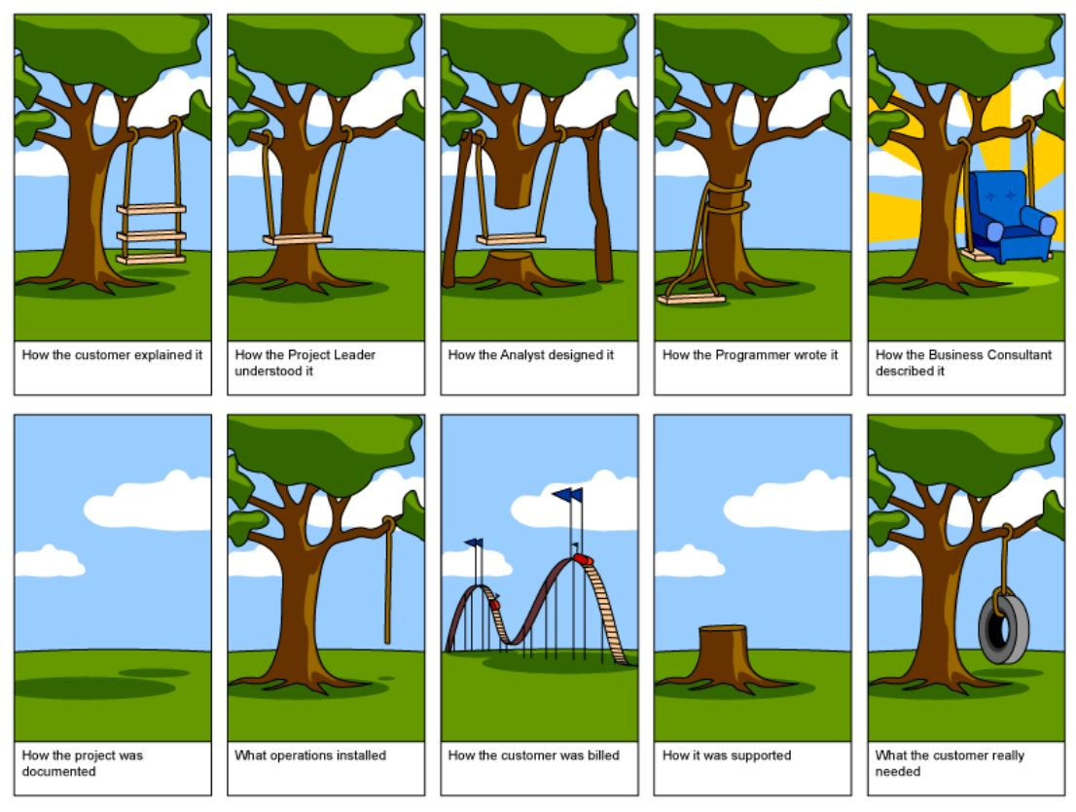

Slide 34
Software Engineering: Big Picture
Requirements Gathering
Surveys
Specification
UML
Implementation
Software code
User studies
Focus groups
Use Cases
Scenarios
Storyboards
APIs
Document formats
Testing
Unit Tests
Black Box Tests
Etc…
Deployment
Configuration
Bug Tracking
User Support
Design
UML
Class Diagrams
Activity Diagrams
Sequence Diagrams
Etc…
SSM
This is rarely a straightforward progression – in reality there are lots of iterations and points of feedback

Slide 35
Software Engineering: Big Picture
Requirements Gathering
Surveys
Specification
UML
Implementation
Software code
User studies
Focus groups
Use Cases
Scenarios
Storyboards
APIs
Document formats
Testing
Unit Tests
Black Box Tests
Etc…
Deployment
Configuration
Bug Tracking
User Support
Design
UML
Class Diagrams
Activity Diagrams
Sequence Diagrams
Etc…
SSM
Definition
Development
Maintenance
This is rarely a straightforward progression – in reality there are lots of iterations and points of feedback

Slide 36
Software Engineering: Big Picture
Requirements Gathering
Surveys
Specification
UML
Implementation
Software code
User studies
Focus groups
Use Cases
Scenarios
Storyboards
APIs
Document formats
Testing
Unit Tests
Black Box Tests
Etc…
Deployment
Configuration
Bug Tracking
User Support
Design
UML
Class Diagrams
Activity Diagrams
Sequence Diagrams
Etc…
SSM
Definition
Development
Maintenance
+‘infrastructure’processes: Project Management, Configuration Management, Quality Assurance, Risk Management
This is rarely a straightforward progression – in reality there are lots of iterations and points of feedback

Slide 37
Software Engineering: Big Picture
Requirements Gathering
Surveys
Specification
UML
Implementation
Software code
User studies
Focus groups
Use Cases
Scenarios
Storyboards
APIs
Document formats
Testing
Unit Tests
Black Box Tests
Etc…
Deployment
Configuration
Bug Tracking
User Support
Design
UML
Class Diagrams
Activity Diagrams
Sequence Diagrams
Etc…
SSM
Definition
Development
Maintenance
We are concentrating our efforts here
This is rarely a straightforward progression – in reality there are lots of iterations and points of feedback

Slide 38
Software process models
Determine the order of the stages of software development.
Establish the transition criteria to proceed from one stage to the next.
What shall we do next?
How long should we take?
Process models have evolved and will continue doing so.
Notes:
This part of the lecture is based on
Boehm, B. W. (1988). "A Spiral Model of Software-Development and Enhancement." Computer 21(5): 61-72.
This is a pivotal paper in which the short comings of the waterfall method lead to the spiral model.

Slide 39
Linear, Sequential Process Models

Slide 40

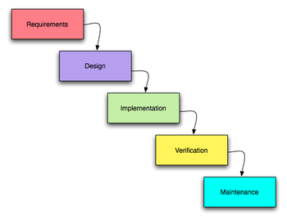
Waterfall Model - Winston Royce 1970
Systematic
Sequential
Highly structured
Problem?

Slide 41
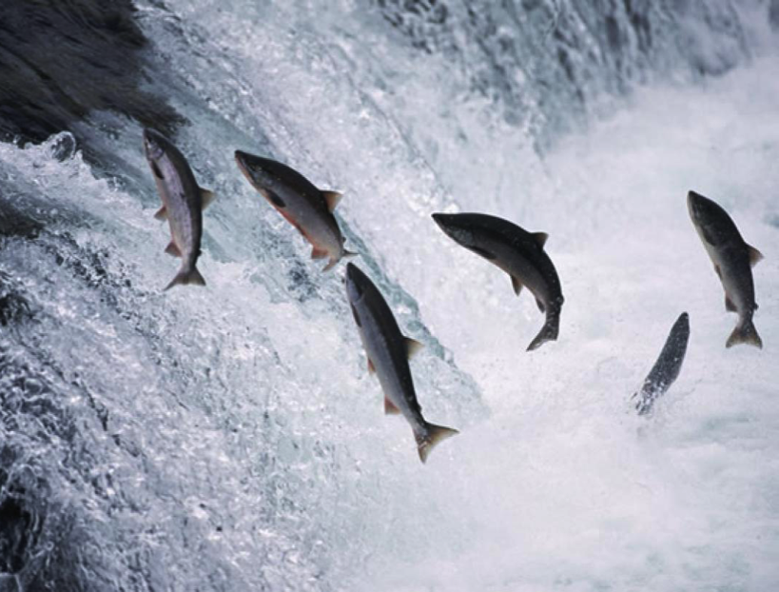
Waterfall Model - Winston Royce 1970
Systematic
Sequential
Highly structured
Problem?

Slide 42
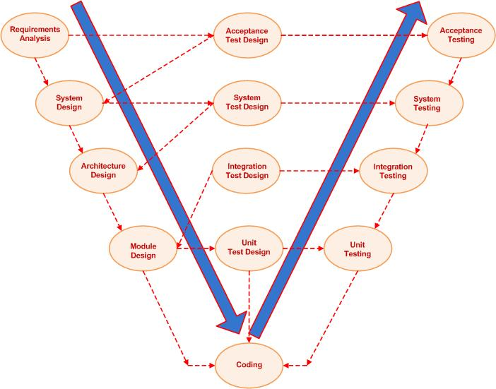
The V-model – Validation and Verification for defect removal
An extension of waterfall.
Sequential
Shows each phase of development with the corresponding testing phase
Defect prevention designed into the process at every stage
Time

Slide 43

So was this the magic bullet?
Can you spot the flaws in this approach?

Slide 44
What’s wrong with the V model?
Specification
Validation testing
Preliminary design
Integration testing
Many specification errors are detected
only after a lot of development has been undertaken
Unit testing
Detailed design
Coding

Slide 45
Summary
Systems are:
a set of things - interacting for - a unified purpose
Systems Design is
Systems theory applied to software
To allow us to build software to solve complex problems
Systems can be viewed
In the small
specific descriptions of how components interact (UML)
For the rest of this week we will look at Requirements Engineering
and modelling

Slide 46
References
Ariane 501 Inquiry Board. Ariane 5 - flight 501 failure.
http://esamultimedia.esa.int/docs/esa-x-1819eng.pdf, July 1996.
Johan Laurenz Eveleens and Chris Verhoef. The rise and fall of the Chaos report figures.IEEE Software, 27(1):30–36, January 2010. https://doi.org/10.1109/MS.2009.154
Nancy Leveson. Medical Devices: The Therac-25, chapter Appendix A. Addison-Wesley, 1995.
Harlan D. Mills. The management of software engineering - part i: Principles of software engineering. IBM Systems Journal, 19(4): 414–420, 1980.
The Project Cartoon. How projects really work (version 2.0).
http://www.projectcartoon.com/cartoon/1, July 2006.

